Slide 1

Analyst
Business Analytics
Analyze NYSE Dataset

Slide 2
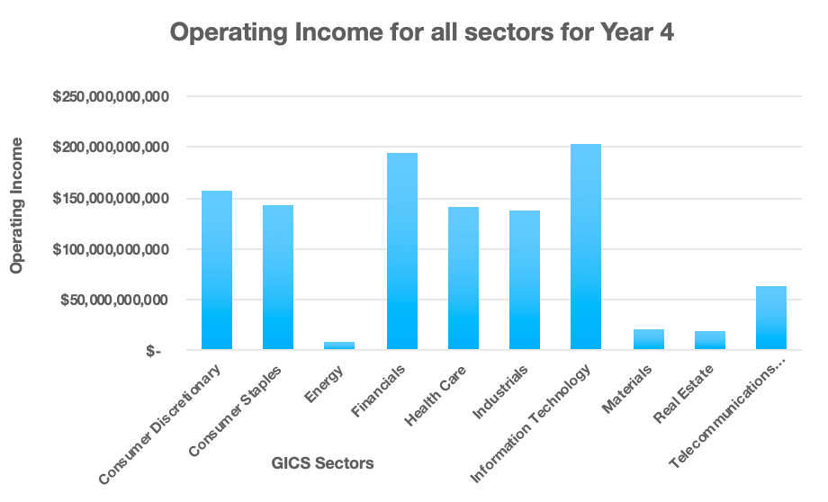
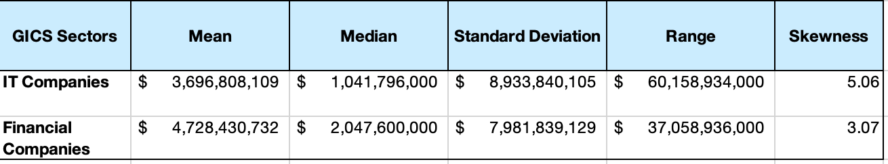
Which Sector has the highest operating Income for Year 4?
First graph clearly shows the Operating Income for IT ($203,324,446,000) is highest amongst all for the year 4. After IT, financial sector has the second highest operating profit ($193,865,659,999).
Although the total for IT is higher, but the Mean Operating Income for IT industry ($3,696,808,109) is lower as compare to financial sector which has mean of $4,728,430,732, the reason could be the few companies in IT have really high Income which is making the whole total operating income higher for IT.
The median Operating Profit for IT industry (1,041,796,000) is lower compared to financial sector which has a median of $2,047,600,000. Looks like 50% of the companies in Finance has higher operating income on average as compared to IT.
The standard deviation of IT ($8,933,840,105) is higher compared to Financial sector ($7,981,839,129), which means that there is high variability in the operating income of different companies in IT field, few companies might have very high income whereas few have lesser.
Again, it is clear from Range that IT (60,158,934,000) has much higher Range compared to Financial sector ($37,058,936,000), which shows the income in different companies are more spread out.
From the skewness , both are right skewed, where mean is greater than the median
Note: I have substituted all $- with $0.01 to make calculation easier.

Slide 3
THANK YOU

